Slide 1
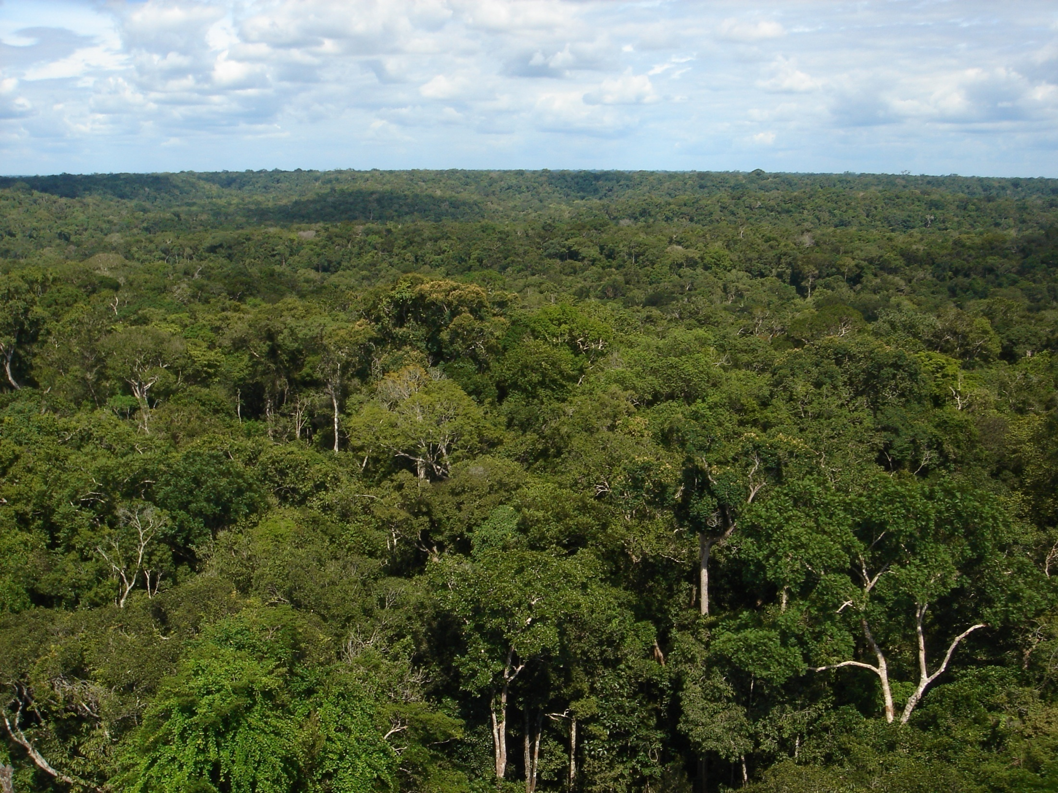
GoAmazon2014/5
Science Conference
May 18-20, 2015, Harvard University
Cambridge, Massachusetts
Welcome! And let’s begin….

Slide 2
How to do acknowledgments vis-à-vis ARM
Users should acknowledge any use of ARM data or the facility as “the Atmospheric Radiation Measurement (ARM) Climate Research Facility, a U.S. Department of Energy Office of Science user facility sponsored by the Office of Biological and Environmental Research”.
For ARM-collected data, “Data were obtained from…” (from MAOS, AOS, etc.)
To recognize other support – such as the logistical AMF-1 support for PI-operated instruments, “We acknowledge logistical support from the ARM Climate Research Facility.”
Source: Sally McFarlane, Program Manager, ARM Climate Research Facility

Slide 3
ARM Data Sets and Instrument Mentors
You are encouraged to interact with the contact person associated with the different ARM data sets. Doing so provides a valuable opportunity to engage and collaborate with the individual that made the measurement associated with the data set.
Go to the campaign data webpage:
http://www.arm.gov/campaigns/amf2014goamazon/
Click on the “Order Data” link for the specific data set. The relevant contact information is provided.

Slide 4
Brazil-side acknowledgments if you entered Brazil
There are many permutations of scientific licenses, nationalities, and projects. My directions below pertain to anyone from an institution in the USA.
Case 1: If you obtained a VITEM-I visa in the USA and worked on any of the ground sites, directions are to include:
“We acknowledge the support from the Central Office of the Large Scale Biosphere Atmosphere Experiment in Amazonia (LBA), the Instituto Nacional de Pesquisas da Amazonia (INPA), and the Universidade do Estado do Amazonia (UEA). The work was conducted under 001030/2012-4 of the Brazilian National Council for Scientific and Technological Development (CNPq).”
Case 2: If you obtained a VITEM-I visa in the USA and worked on the G1 aircraft, directions are to include the following:
“We acknowledge the support from the Central Office of the Large Scale Biosphere Atmosphere Experiment in Amazonia (LBA), the Instituto Nacional de Pesquisas da Amazonia (INPA), and the Instituto Nacional de Pesquisas Espaciais (INPE). The work was conducted under 001262/2012-2 of the Brazilian National Council for Scientific and Technological Development (CNPq).”
Case 3: If you obtained a VITEM-I visa in the USA and worked on the HALO aircraft, directions are to include the following:
“We acknowledge the support from the Central Office of the Large Scale Biosphere Atmosphere Experiment in Amazonia (LBA), the Instituto Nacional de Pesquisas da Amazonia (INPA), the Instituto Nacional de Pesquisas Espaciais (INPE), the Agência Espacial Brasileira (AEB), the Max Planck Society, the Deutsche Forschungsgesellschaft (DFG), and the German Aerospace Center (DLR). The work was conducted under 2009/15235-8 of the Fundação de Amparo à Pesquisa do Estado de São Paulo (FAPESP) and 00254/2013-9 of the Brazilian National Council for Scientific and Technological Development (CNPq).”
People from other institutions in Brazil or outside USA should think through which of the foregoing might apply to them, too.

Slide 5
Brazil-side acknowledgments if you use data sets collected in Brazil
There are many permutations of scientific licenses, nationalities, and projects. My directions below pertain to anyone from an institution in the USA.
Case 1: If you use data obtained from the ARM server or directly from any USA-based PI for any of the ground sites, directions are to include the following:
“We acknowledge the support from the Central Office of the Large Scale Biosphere Atmosphere Experiment in Amazonia (LBA), the Instituto Nacional de Pesquisas da Amazonia (INPA), and the Universidade do Estado do Amazonia (UEA). The work was conducted under 001030/2012-4 of the Brazilian National Council for Scientific and Technological Development (CNPq).”
Case 2: If you use data obtained using the G1 aircraft, directions are to include the following:
“We acknowledge the support from the Central Office of the Large Scale Biosphere Atmosphere Experiment in Amazonia (LBA), the Instituto Nacional de Pesquisas da Amazonia (INPA), and the Instituto Nacional de Pesquisas Espaciais (INPE). The work was conducted under 001262/2012-2 of the Brazilian National Council for Scientific and Technological Development (CNPq).”
Case 3: If you use data obtained using the HALO aircraft, directions are to include the following:
“We acknowledge the support from the Central Office of the Large Scale Biosphere Atmosphere Experiment in Amazonia (LBA), the Instituto Nacional de Pesquisas da Amazonia (INPA), the Instituto Nacional de Pesquisas Espaciais (INPE), the Agência Espacial Brasileira (AEB), the Max Planck Society, the Deutsche Forschungsgesellschaft (DFG), and the German Aerospace Center (DLR). The work was conducted under 2009/15235-8 of the Fundação de Amparo à Pesquisa do Estado de São Paulo (FAPESP) and 00254/2013-9 of the Brazilian National Council for Scientific and Technological Development (CNPq).”
Continued next page.

Slide 6
Brazil-side acknowledgments if you use data sets collected in Brazil
Continued from previous page.
Case 4: If you use data obtained from the CHUVA server for any of the ground sites, directions are to include the following:
“We acknowledge the support from the Central Office of the Large Scale Biosphere Atmosphere Experiment in Amazonia (LBA), the Instituto Nacional de Pesquisas da Amazonia (INPA), and the Instituto Nacional de Pesquisas Espaciais (INPE). The work was conducted under 2009/15235-8 of the Fundação de Amparo à Pesquisa do Estado de São Paulo (FAPESP).”
People from other institutions in Brazil or outside USA should think through which of the foregoing might apply to them, too.

Slide 7
More acknowledgments
These acknowledgments have related to things at the highest level, specifically as related to governing scientific licenses.
In addition, there are other acknowledgments that could be appropriate as tied to specific projects, such as from NSF, DOE, FAPEAM, FAPESP, and more.
These acknowledgments are on a case-by-case basis, and you should consult appropriate PI’s involved in the projects or in the data sets for specific language to include.
When you are in doubt, write to scot_martin@harvard.edu.

